Slide 2
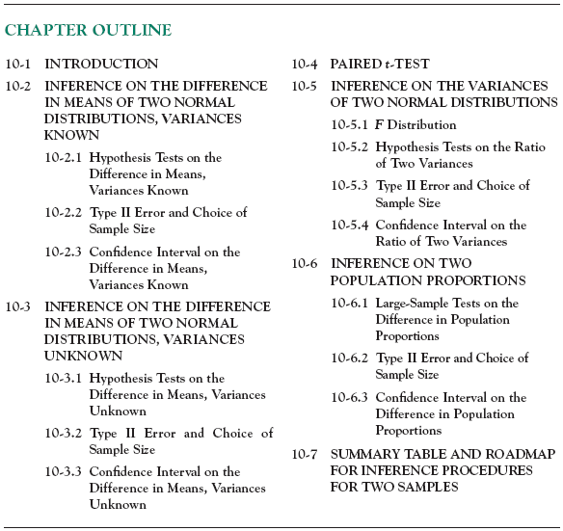

Slide 4
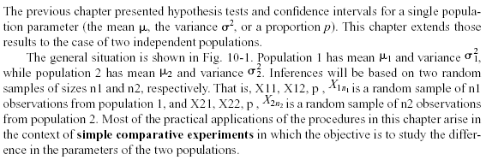
10-1 Introduction

Slide 5
10-2 Inference for a Difference in Means of Two Normal Distributions, Variances Known
Figure 10-1 Two independent populations.

Slide 6
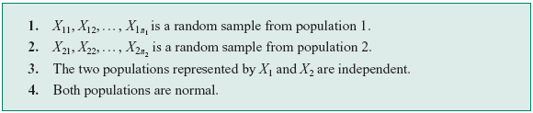

10-2 Inference for a Difference in Means of Two Normal Distributions, Variances Known
Assumptions

Slide 7






10-2 Inference for a Difference in Means of Two Normal Distributions, Variances Known

Slide 8
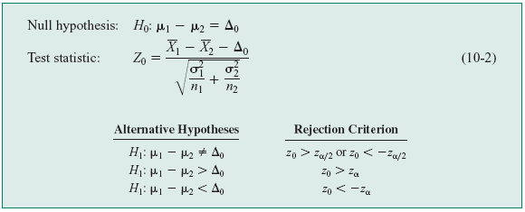






10-2 Inference for a Difference in Means of Two Normal Distributions, Variances Known
10-2.1 Hypothesis Tests for a Difference in Means,
Variances Known

Slide 9
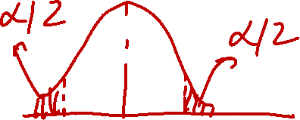

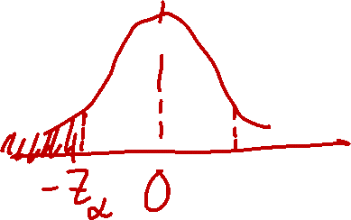

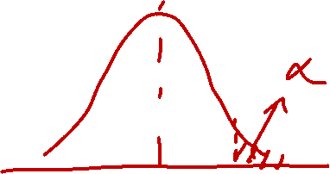



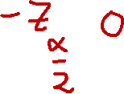

Slide 10
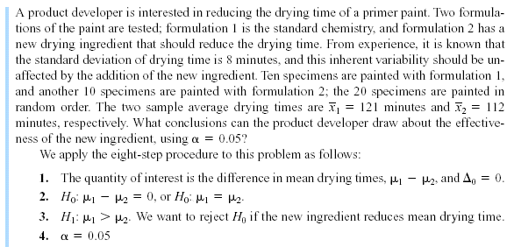



10-2 Inference for a Difference in Means of Two Normal Distributions, Variances Known
Example 10-1

Slide 11
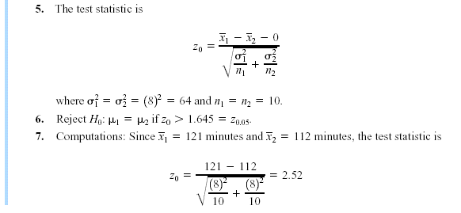
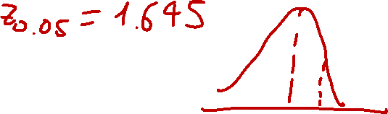



10-2 Inference for a Difference in Means of Two Normal Distributions, Variances Known
Example 10-1

Slide 12
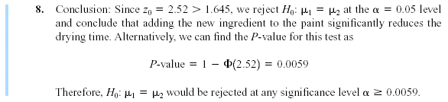





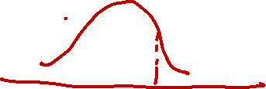

10-2 Inference for a Difference in Means of Two Normal Distributions, Variances Known
Example 10-1

Slide 13
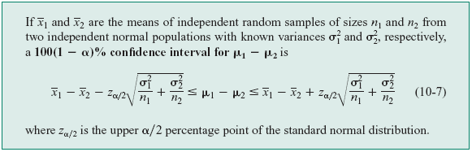

10-2 Inference for a Difference in Means of Two Normal Distributions, Variances Known
10-2.3 Confidence Interval on a Difference in Means,
Variances Known
Definition

Slide 14
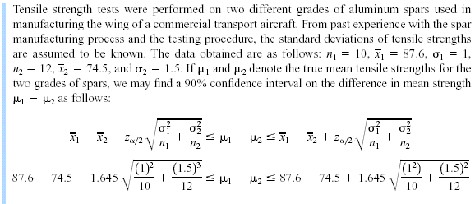
10-2 Inference for a Difference in Means of Two Normal Distributions, Variances Known
Example 10-4

Slide 15
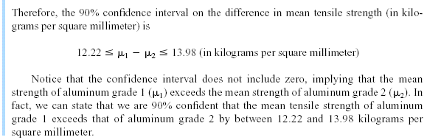
10-2 Inference for a Difference in Means of Two Normal Distributions, Variances Known
Example 10-4

Slide 16

10-2 Inference for a Difference in Means of Two Normal Distributions, Variances Known
Choice of Sample Size

Slide 17


10-2 Inference for a Difference in Means of Two Normal Distributions, Variances Known
One-Sided Confidence Bounds
Upper Confidence Bound
Lower Confidence Bound

Slide 18













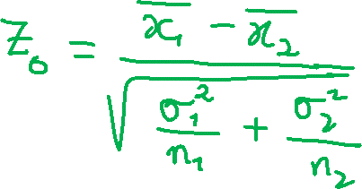






Slide 19
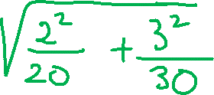












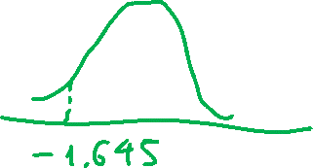


Slide 20




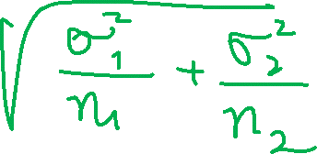

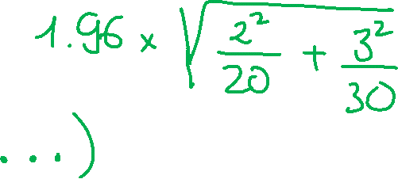

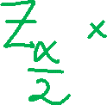








Slide 21






Slide 22

10-3 Inference for a Difference in Means of Two Normal Distributions, Variances Unknown
10-3.1 Hypotheses Tests for a Difference in Means, Variances Unknown
$$σ_{1}^{2}=σ_{2}^{2}=σ^{2}$$
Case 1:
We wish to test:

Slide 23
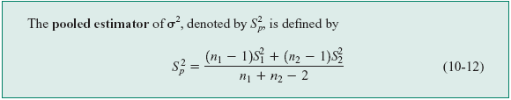
10-3 Inference for a Difference in Means of Two Normal Distributions, Variances Unknown
10-3.1 Hypotheses Tests for a Difference in Means, Variances Unknown
$$σ_{1}^{2}=σ_{2}^{2}=σ^{2}$$
Case 1:
The pooled estimator of σ²:

Slide 24



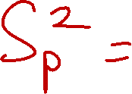

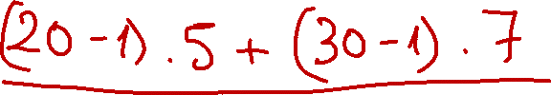







Slide 25
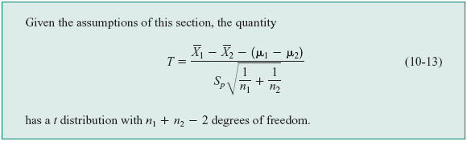
10-3 Inference for a Difference in Means of Two Normal Distributions, Variances Unknown
10-3.1 Hypotheses Tests for a Difference in Means, Variances Unknown
$$σ_{1}^{2}=σ_{2}^{2}=σ^{2}$$
Case 1:

Slide 26
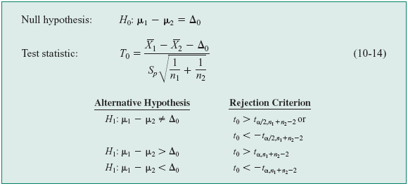

10-3 Inference for a Difference in Means of Two Normal Distributions, Variances Unknown
Definition: The Two-Sample or Pooled t-Test*

Slide 27









10-3 Inference for a Difference in Means of Two Normal Distributions, Variances Unknown
Example 10-5

Slide 28
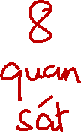
10-3 Inference for a Difference in Means of Two Normal Distributions, Variances Unknown
Example 10-5

Slide 29

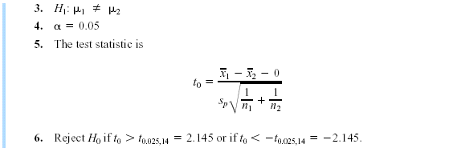



10-3 Inference for a Difference in Means of Two Normal Distributions, Variances Unknown
Example 10-5

Slide 30
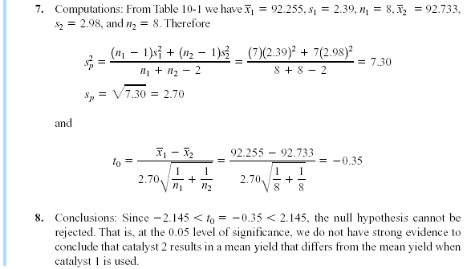
10-3 Inference for a Difference in Means of Two Normal Distributions, Variances Unknown
Example 10-5

Slide 31
10-3 Inference for a Difference in Means of Two Normal Distributions, Variances Unknown
Minitab Output for Example 10-5

Slide 32
10-3 Inference for a Difference in Means of Two Normal Distributions, Variances Unknown
Figure 10-2 Normal probability plot and comparative box plot for the catalyst yield data in Example 10-5. (a) Normal probability plot, (b) Box plots.

Slide 33

10-3 Inference for a Difference in Means of Two Normal Distributions, Variances Unknown
10-3.1 Hypotheses Tests for a Difference in Means, Variances Unknown
Case 2:
$$σ_{1}^{2}≠σ_{2}^{2}$$
is distributed approximately as t with degrees of freedom given by

Slide 34

10-3 Inference for a Difference in Means of Two Normal Distributions, Variances Unknown
10-3.1 Hypotheses Tests for a Difference in Means, Variances Unknown
Case 2:
$$σ_{1}^{2}≠σ_{2}^{2}$$

Slide 35
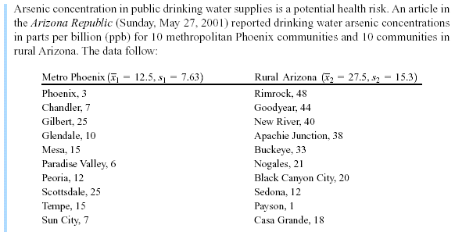



10-3 Inference for a Difference in Means of Two Normal Distributions, Variances Unknown
Example 10-6

Slide 36

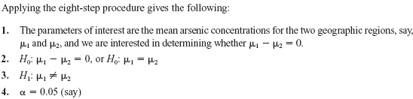
10-3 Inference for a Difference in Means of Two Normal Distributions, Variances Unknown
Example 10-6 (Continued)

Slide 37
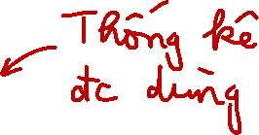
10-3 Inference for a Difference in Means of Two Normal Distributions, Variances Unknown
Example 10-6 (Continued)

Slide 38
10-3 Inference for a Difference in Means of Two Normal Distributions, Variances Unknown
Example 10-6 (Continued)
Figure 10-3 Normal probability plot of the arsenic concentration data from Example 10-6.

Slide 39
10-3 Inference for a Difference in Means of Two Normal Distributions, Variances Unknown
Example 10-6 (Continued)

Slide 40
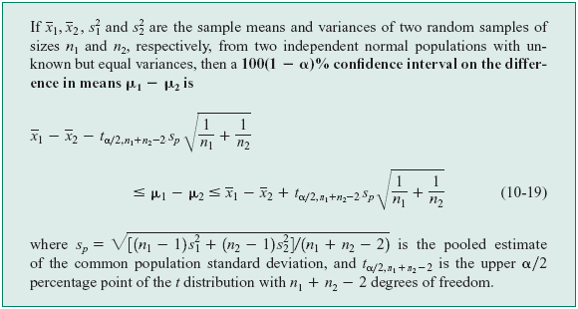
10-3 Inference for a Difference in Means of Two Normal Distributions, Variances Unknown
10-3.3 Confidence Interval on the Difference in Means, Variance Unknown
$$σ_{1}^{2}=σ_{2}^{2}=σ^{2}$$
Case 1:

Slide 41
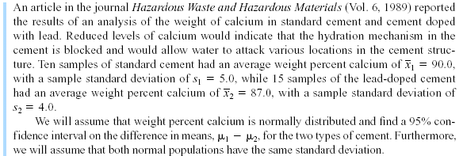
10-3 Inference for a Difference in Means of Two Normal Distributions, Variances Unknown
$$σ_{1}^{2}=σ_{2}^{2}=σ^{2}$$
Case 1:
Example 10-8

Slide 42
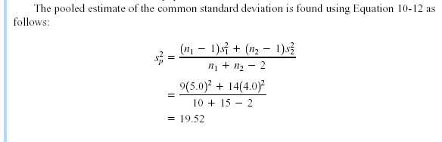
10-3 Inference for a Difference in Means of Two Normal Distributions, Variances Unknown
$$σ_{1}^{2}=σ_{2}^{2}=σ^{2}$$
Case 1:
Example 10-8 (Continued)

Slide 43
10-3 Inference for a Difference in Means of Two Normal Distributions, Variances Unknown
$$σ_{1}^{2}=σ_{2}^{2}=σ^{2}$$
Case 1:
Example 10-8 (Continued)

Slide 44
10-3 Inference for a Difference in Means of Two Normal Distributions, Variances Unknown
$$σ_{1}^{2}=σ_{2}^{2}=σ^{2}$$
Case 1:
Example 10-8 (Continued)

Slide 45
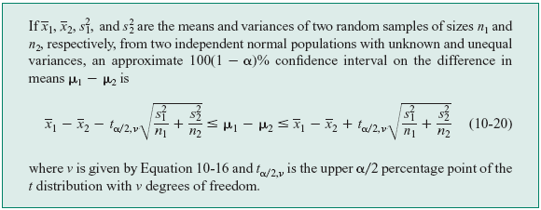
10-3 Inference for a Difference in Means of Two Normal Distributions, Variances Unknown
10-3.3 Confidence Interval on the Difference in Means, Variance Unknown
$$σ_{1}^{2}≠σ_{2}^{2}$$
Case 2:

Slide 46

10-6 Inference on Two Population Proportions
10-6.1 Large-Sample Test on the Difference in Population Proportions
We wish to test the hypotheses:

Slide 47




10-6 Inference on Two Population Proportions
10-6.1 Large-Sample Test on the Difference in Population Proportions
The following test statistic is distributed approximately as standard normal and is the basis of the test:

Slide 48
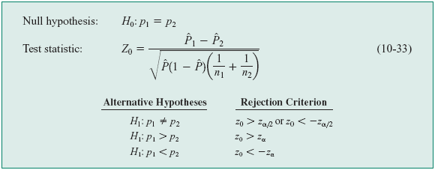
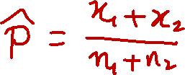
10-6 Inference on Two Population Proportions
10-6.1 Large-Sample Test on the Difference in Population Proportions

Slide 49




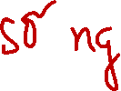

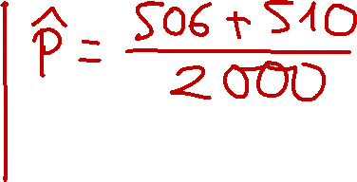













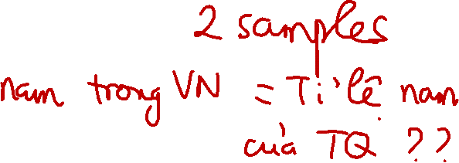


Slide 50
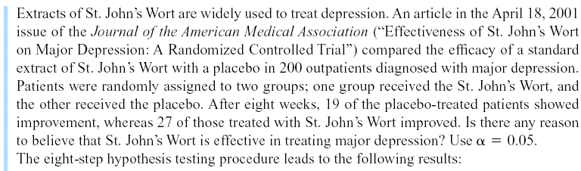







10-6 Inference on Two Population Proportions
Example 10-14

Slide 51
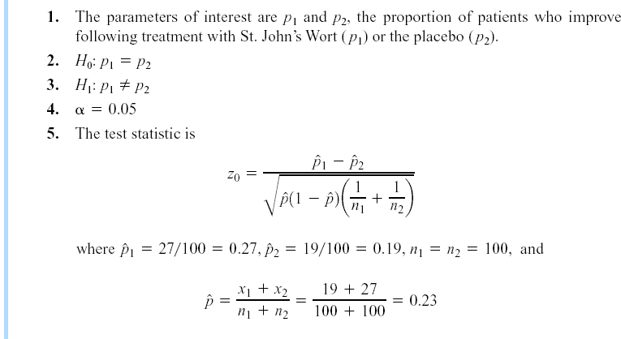
10-6 Inference on Two Population Proportions
Example 10-14

Slide 52
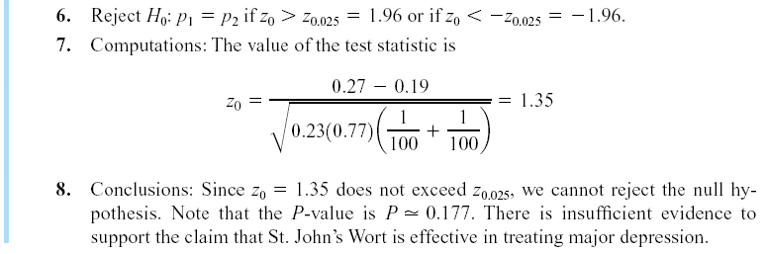
10-6 Inference on Two Population Proportions
Example 10-14

Slide 53
10-6 Inference on Two Population Proportions
Minitab Output for Example 10-14

Slide 54

10-6 Inference on Two Population Proportions
10-6.3 Confidence Interval on the Difference in the Population Proportions

Slide 55
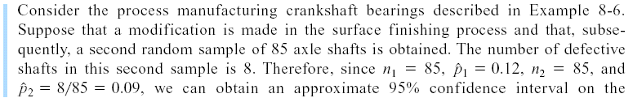
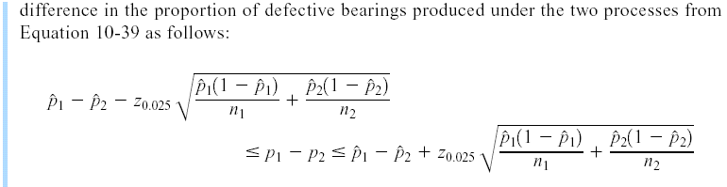
10-6 Inference on Two Population Proportions
Example 10-15

Slide 56
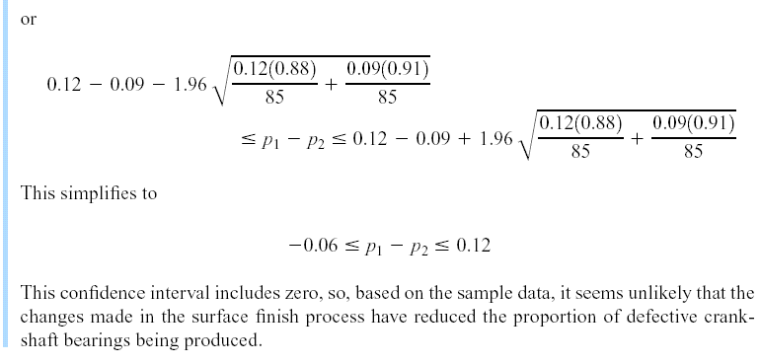
10-6 Inference on Two Population Proportions
Example 10-15

Slide 57





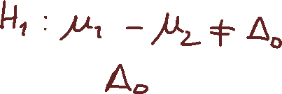








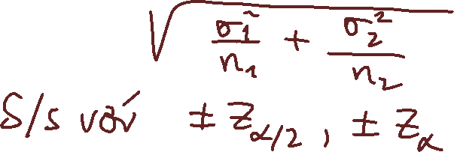



Slide 58












Slide 59










Slide 60















Slide 61





Slide 62
10-7 Summary Table and Road Map for Inference Procedures for Two Samples
Table 10-4

Slide 63

10-7 Summary Table and Road Map for Inference Procedures for Two Samples
Table 10-4 (Continued)

